Slide 1


















CORPORATE EQUIPMENT ALLOCATION SYSTEM
RITIK JANARDHAN KOLI
Play Framework
Kafka
Akka
Slick

Slide 2











PROBLEM STATEMENT
Manual Allocation
No Automated Reminders
Manual equipment allocation is slow and error-prone, leading to resource conflicts and inefficient utilization.
No automated overdue reminders result in missed deadlines and potential equipment shortages.
Inventory Inaccuracy
Lack of Scalability
Inventory not updated in real-time causes discrepancies between recorded and actual equipment status.
Lack of scalable event-driven solution prevents efficient management of growing equipment demands.
2 / 11

Slide 3


















SOLUTION & APPROACH
Play Framework
Kafka
Akka
REST API for CRUD operations
Event-driven design
Async processing
Scheduler
MySQL + Slick
Email Notifications
Overdue checks
Persistence layer
Via SMTP
3 / 11

Slide 4
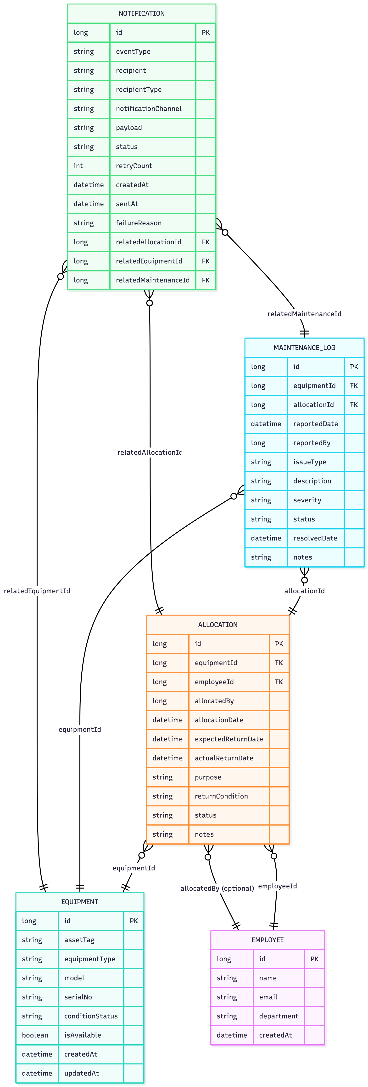
ER DIAGRAM
4 / 11

Slide 5

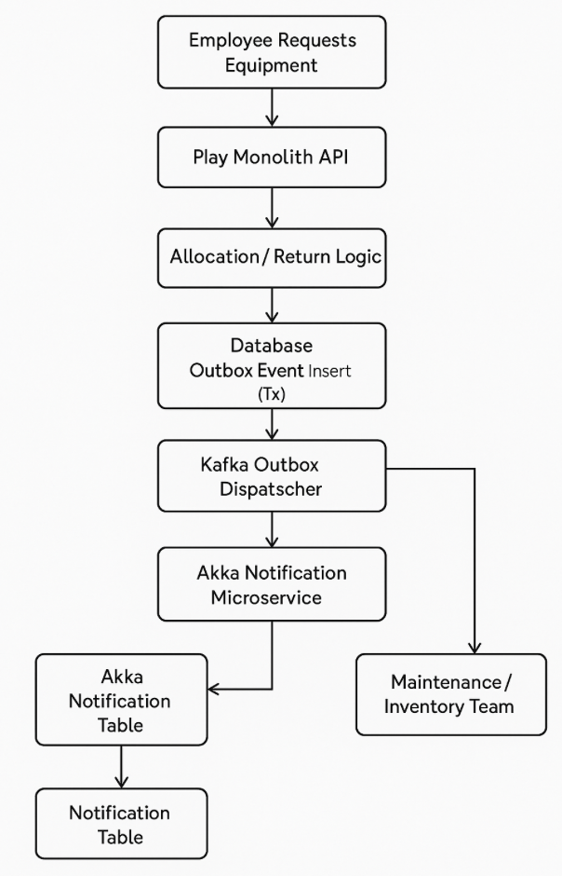
FUNCTIONAL FLOW DIAGRAM
5 / 11

Slide 6
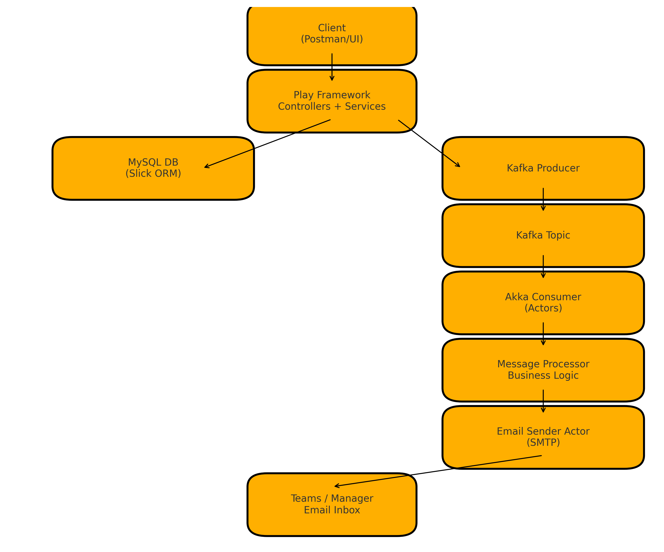
OVERALL ARCHITECTURE DIAGRAM
6 / 11

Slide 7

















DEPLOYMENT PLAN
Play Monolith
Deployed locally on application server
Kafka Broker
Local Machine
Remote Server
Hosted locally as message broker
Play Monolith
Akka Microservice
Kafka Broker
MySQL Database
Akka Microservice
Deployed separately for async processing
MySQL Database
Persistent storage for system data
System Communication via Kafka Topics
7 / 11

Slide 8
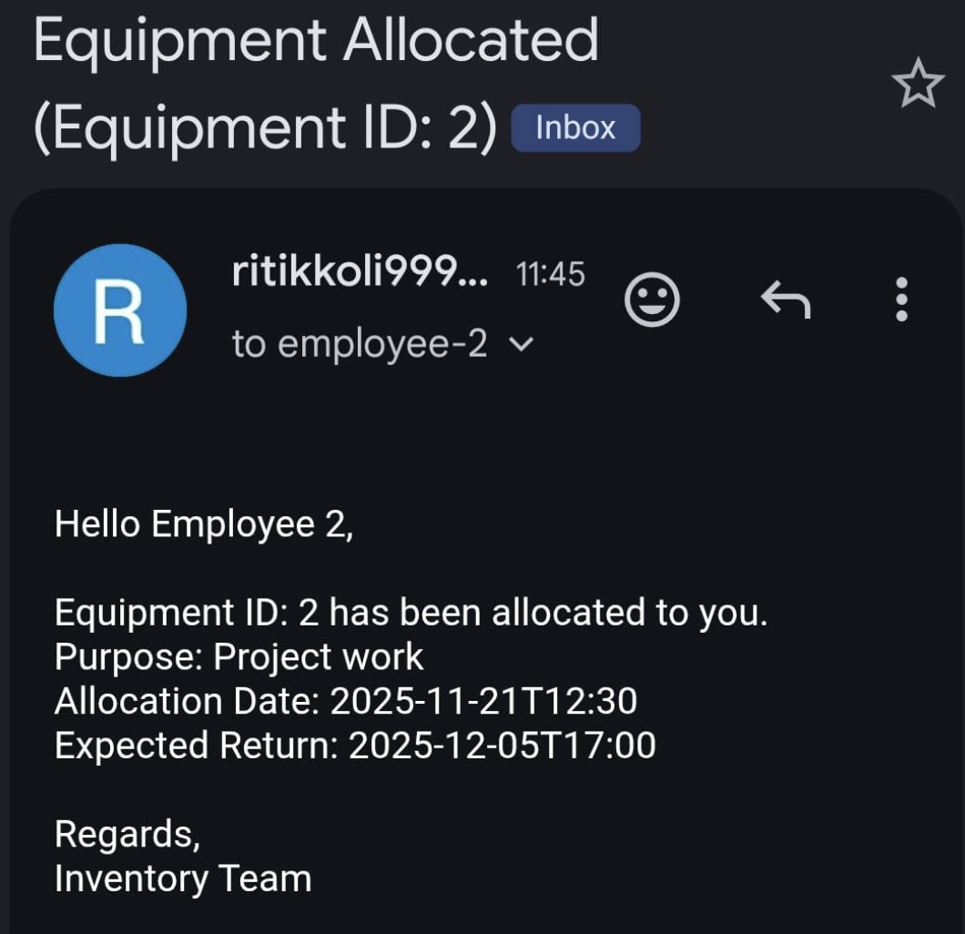
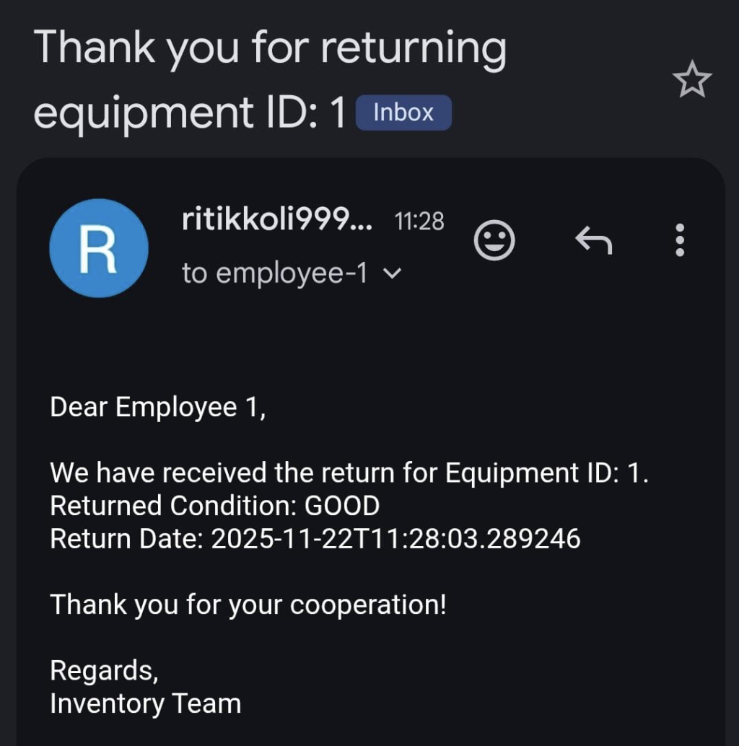
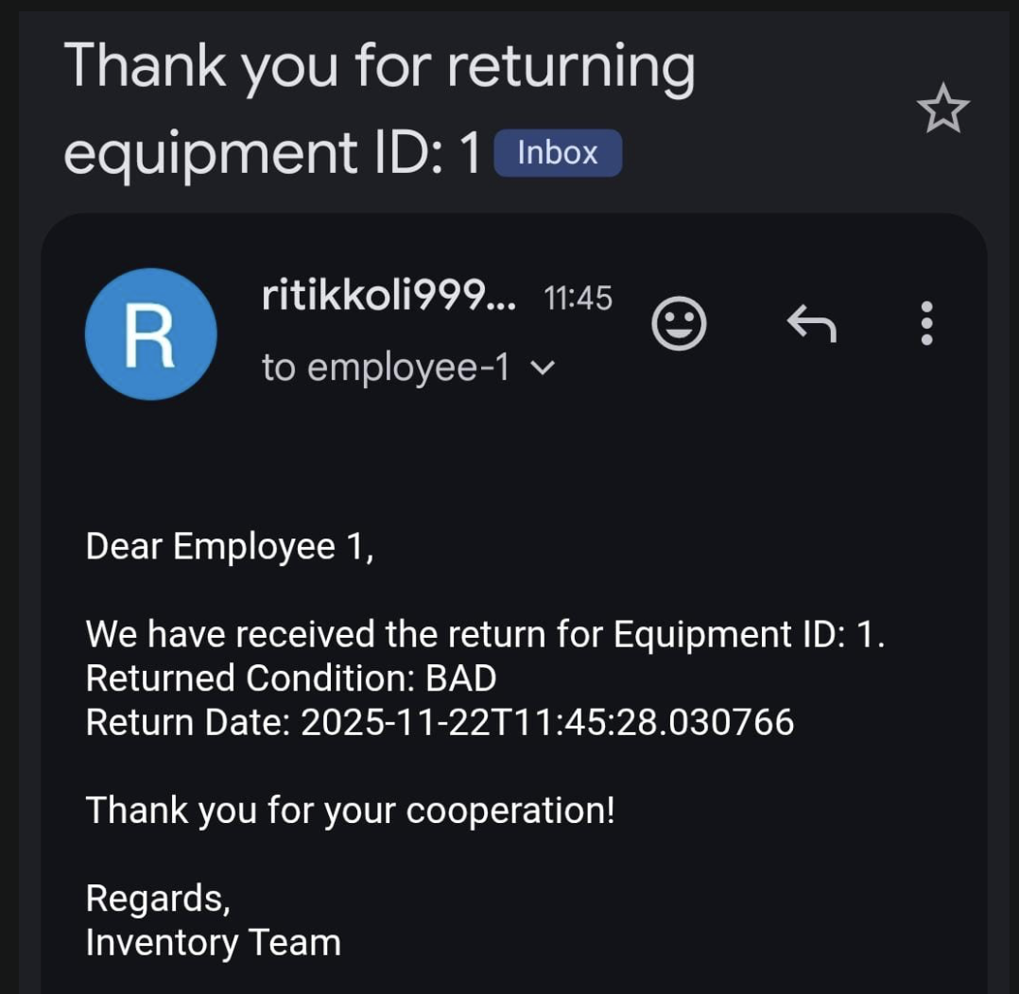
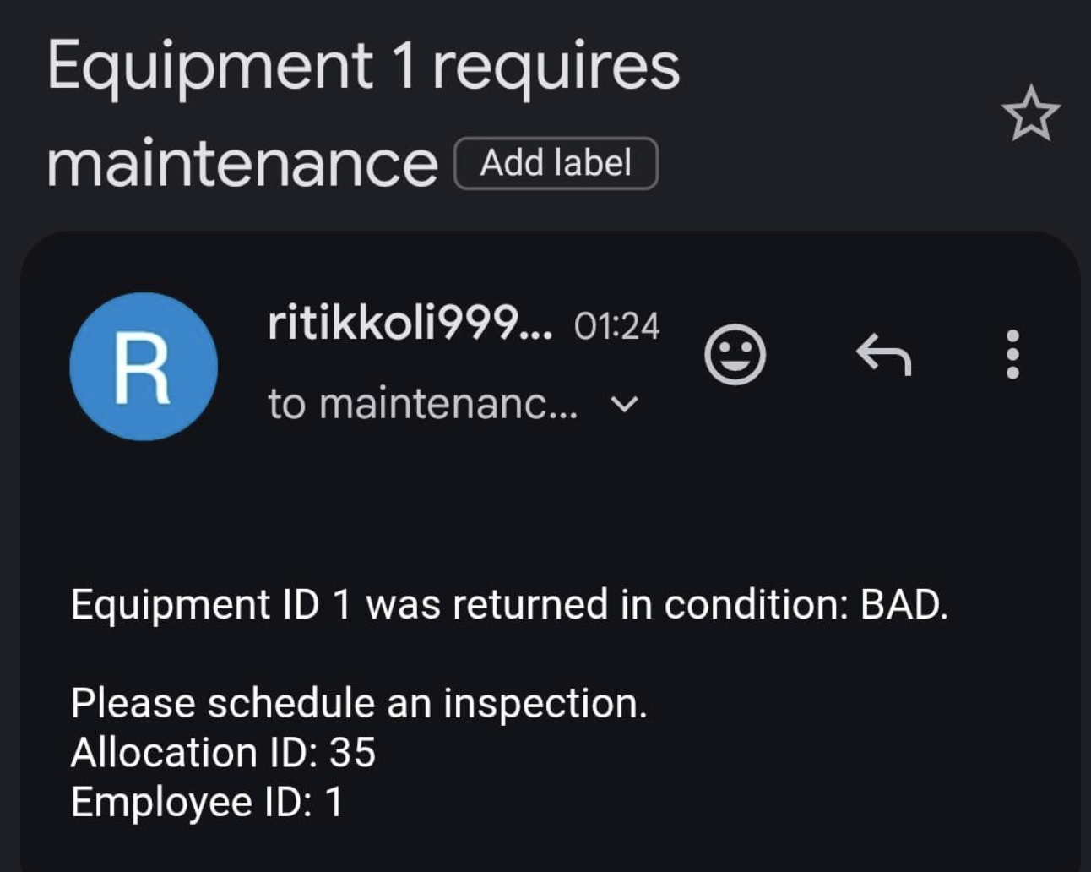
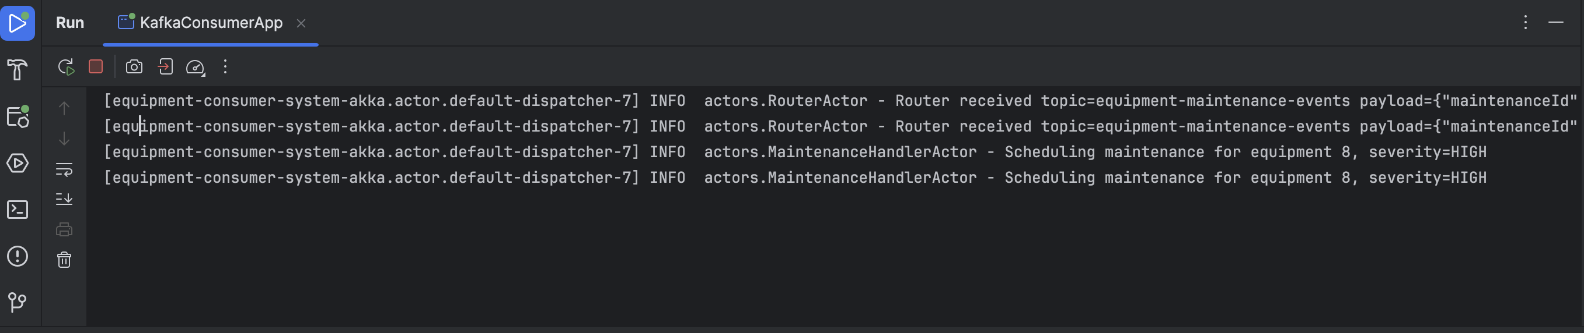
OUTPUT
8 / 11

Slide 9



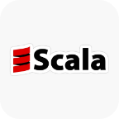









TECH FEATURES IMPLEMENTED
Scala
Akka Actors
Case classes for immutable data models and JSON formats for serialization.
Notification, Inventory, and Router actors for concurrent processing.
Akka Scheduling
Kafka
Scheduled tasks for periodic overdue alerts and system checks.
Producer and consumer for event-driven communication between components.
Play Framework
Slick MySQL
MVC controllers and routing for RESTful APIs and web interface.
DAO layer for type-safe database operations with MySQL.
9 / 11

Slide 10





CONCLUSION & FUTURE SCOPE
Key Conclusions
Future Scope
Implemented event-driven architecture using Kafka for efficient communication between system components
Implement equipment tracking using RFID technology for real-time location monitoring
Akka actors enabled reliable and scalable processing of equipment allocation events
Add machine learning capabilities for equipment demand forecasting
Play Framework REST API provided clean interface for CRUD operations
Develop mobile application for equipment request and allocation
Slick ORM ensured type-safe database operations with MySQL persistence
Implement resource optimization algorithms to maximize equipment utilization
Email notifications via SMTP improved communication and reduced manual follow-ups
Add analytics dashboard for equipment usage patterns and insights
10 / 11

Slide 11






THANK YOU
For your attention to the Corporate Equipment Allocation System
RITIK JANARDHAN KOLI
11 / 11

